Slide 1

Multicast Communication
By Santosh Bhandari

Slide 2

What is Communication?
Communication is the process of exchanging information, ideas, or messages between individuals or groups. It can occur through various mediums such as speech, writing, gestures, or technology.
In Computer Network, Communication is a networking technique where data or Information is sent from one sender to another specific recipients using different protocols and standards.

Slide 3



Types of Communication Methods
Unicast
Multicast
Broadcast
One-to-one communication between a single sender and receiver.
One-to-many communication from a single sender to a select group.
One-to-all communication from a single sender to all possible receivers.

Slide 4

MULTICAST
Multicast is a communication method where data is transmitted from a single source to multiple destinations simultaneously. Unlike traditional unicast communication, where data is sent from one point to another, multicast allows a single sender to transmit information to a group of receivers.
The key characteristic of multicast is that the data is only copied once on the network, and then distributed to the group of interested receivers. This approach is more efficient than sending individual copies of the data to each recipient, as it reduces network congestion and resource utilization.

Slide 5
The Protocol Used in Multicast Communication
1
Internet Group Management Protocol (IGMP)
2
Protocol Independent Multicast (PIM)
IGMP is the standard protocol used to manage multicast group membership. It allows hosts to join and leave multicast groups.
PIM is the routing protocol used to build multicast distribution trees and forward multicast traffic. It works with both IPv4 and IPv6 networks.
3
Real-Time Transport Protocol (RTP)
RTP provides end-to-end network transport functions suitable for applications transmitting real-time data, such as audio and video.

Slide 6
Advantages of Multicast Communication
1
Efficient Data Delivery
2
Scalable Deployment
Multicast reduces network bandwidth by only transmitting data once, rather than sending individual copies to each recipient.
As the number of receivers increases, multicast becomes more efficient compared to unicast, making it highly scalable.
3
Real-Time Streaming
Multicast is well-suited for real-time applications like video and audio streaming, where data needs to be delivered to multiple clients simultaneously.

Slide 7
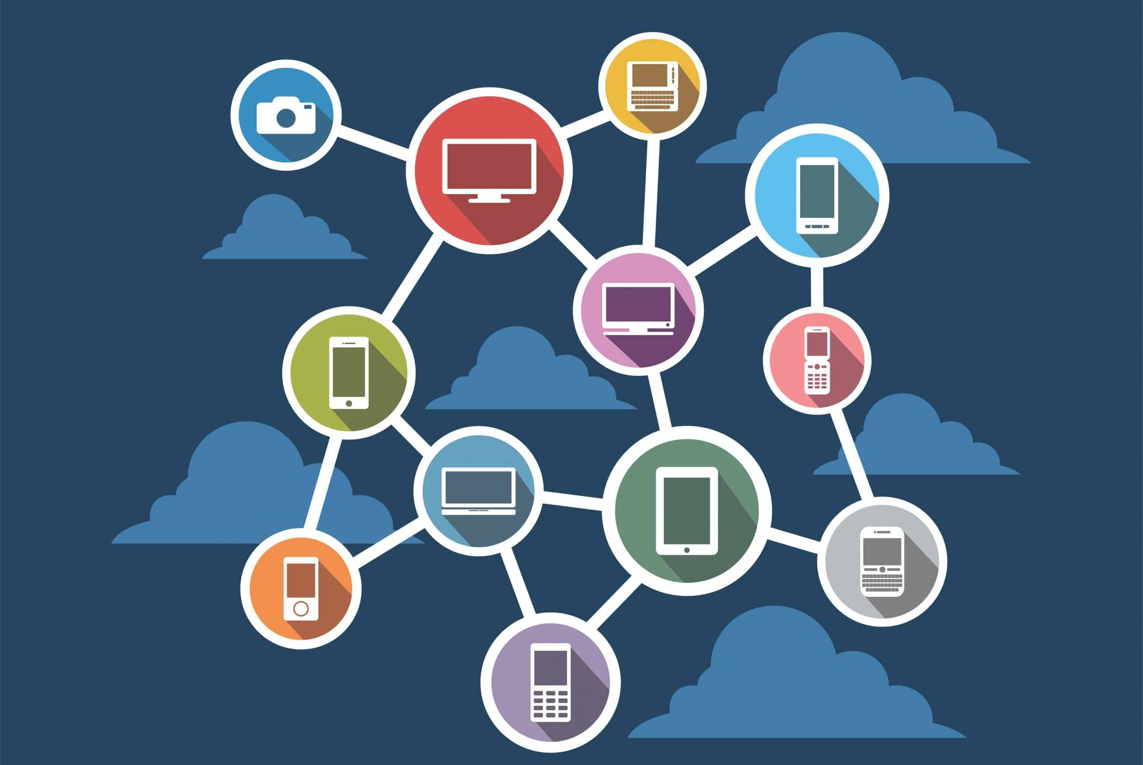
Distributed System
A distributed system is a collection of independent computers that appear to the users of the system as a single coherent system. These computers communicate and coordinate their actions by passing messages to achieve a common goal. Distributed systems are designed to share resources, provide redundancy, and improve performance and reliability.

Slide 8
Applications of Multicast in Distributed Systems
1
Data Distribution
2
Distributed File Sharing
Multicast is ideal for distributing data such as software updates or media streams to multiple users simultaneously.
Multicast can be used to distribute large files across a network of peers in a scalable and bandwidth-efficient manner.
3
Real-time Communication
4
Sensor Networks
Used in applications requiring real-time data transfer, like video conferencing, online gaming, and collaborative workspaces where multiple users interact simultaneously
Multicast is well-suited for monitoring and control applications in sensor networks, where data needs to be delivered to multiple endpoints.

Slide 9
Why Multicast is Essential in Distributed Systems
1
Scalability
2
Bandwidth Optimization
Multicast enables efficient one-to-many communication, allowing a single source to reach multiple recipients simultaneously without the need for individual point-to-point connections.
By replicating data packets only at branch points in the network, multicast reduces overall bandwidth consumption compared to unicast (one-to-one) communication.
3
Dynamic Membership
4
Resource Efficiency
Multicast groups allow for dynamic addition and removal of members, making it well-suited for applications with constantly changing participants, like video conferencing or live events.
Multicast reduces the load on servers and network infrastructure by offloading data distribution to the network, leading to more efficient use of computing and network resources.

Slide 10

Case Study
Online Gaming with Real-Time Multiplayer Features

Slide 11
Case Study
Online Gaming with Real-Time Multiplayer Features
Scenario:
Consider a popular online multiplayer game where thousands of players participate in real-time. The game server needs to send frequent updates about the game state, such as player positions, movements, and actions, to all players. Using multicast, the server can efficiently distribute these updates to all players in a game session.
Analysis:
Efficiency:
Unicast Approach: Without multicast, the server would need to send individual updates to each player. If there are 10,000 players, the server has to send 10,000 separate messages for each update, consuming significant bandwidth and processing power.
Multicast Approach: With multicast, the server sends a single update message to a multicast group. The network infrastructure, such as routers and switches, handles the replication of this message to all group members. This reduces the load on the server as it only sends one message regardless of the number of players.

Slide 12
Case Study
Online Gaming with Real-Time Multiplayer Features
Reduced Bandwidth Consumption:
Server-Side Bandwidth: By sending one multicast message instead of thousands of unicast messages, the bandwidth required on the server-side is drastically reduced. This is especially important during peak hours when the number of active players is highest.
Minimal Latency:
Synchronization: Multicast ensures that all players receive the update at nearly the same time. This is critical in fast-paced multiplayer games where even a slight delay can affect gameplay.
Improved User Experience:
Smoother Gameplay: Players experience smoother and more responsive gameplay due to reduced latency and efficient bandwidth usage. This is crucial in maintaining player engagement and satisfaction.
Consistent Updates: Since all players receive updates simultaneously, the game state remains consistent for everyone, preventing unfair advantages and improving the overall fairness of the game.

Slide 13
Case Study
Online Gaming with Real-Time Multiplayer Features
Scalability:
Growing User Base: As the game gains popularity, the number of concurrent players can increase significantly. Multicast allows the game to scale efficiently without requiring a proportional increase in server resources.
Resource Management: The server can handle more players with the same amount of resources. This allows the game developers to focus on improving game features and content rather than constantly upgrading server infrastructure.
By utilizing multicast communication, the online gaming platform can deliver real-time updates efficiently, enhance player experience, and support a growing user base without compromising performance. This approach ensures that the game remains engaging and fair, maintaining its popularity and user satisfaction.

Slide 14
Challenges and Considerations for Multicast in Distributed Systems
Network Configuration
Security
Compatibility
Multicast communication introduces potential security risks, such as unauthorized access to multicast groups or the ability to inject malicious data into the multicast stream. Securing multicast communication is essential and may involve techniques like access control, encryption, and authentication.
Ensuring compatibility across different network devices, protocols, and software implementations is crucial for the successful deployment of multicast in a distributed system. This may require the use of standards-based multicast protocols and careful testing to verify interoperability.
Implementing multicast communication in a distributed system requires proper network configuration and setup. This includes enabling multicast routing protocols, configuring multicast group addresses, and ensuring that all network devices and routers support multicast forwarding.

Slide 15

Conclusion
In summary, multicast communication is a powerful mechanism for efficient and scalable data distribution in distributed systems. Multicast Communication can be used for different purposes based on the requirements. It also used in Distributed System for the sharing the data and files between the systems and servers.

Slide 16


